Slide 1
Chapter 2
Processes and Threads
Tanenbaum, Modern Operating Systems 3 e, (c) 2008 Prentice-Hall, Inc. All rights reserved. 0-13-6006639

Slide 2
What is a process?
An instance of a program, replete with registers, variables, and a program counter
It has a program, input, output and a state
Why is this idea necessary?
  A computer manages many computations concurrently-need an abstraction to describe how it does it
Tanenbaum, Modern Operating Systems 3 e, (c) 2008 Prentice-Hall, Inc. All rights reserved. 0-13-6006639

Slide 3

Multiprogramming
(a) Multiprogramming of four programs. (b) Conceptual model of four independent, sequential processes. (c) Only one program is active at once.
Tanenbaum, Modern Operating Systems 3 e, (c) 2008 Prentice-Hall, Inc. All rights reserved. 0-13-6006639

Slide 4
Process Creation
Events which can cause process creation
System initialization.
Execution of a process creation system call by a running process.
A user request to create a new process.
Initiation of a batch job.
Tanenbaum, Modern Operating Systems 3 e, (c) 2008 Prentice-Hall, Inc. All rights reserved. 0-13-6006639

Slide 5
Process Termination
Events which cause process termination:
Normal exit (voluntary).
Error exit (voluntary).
Fatal error (involuntary).
Killed by another process (involuntary).
Tanenbaum, Modern Operating Systems 3 e, (c) 2008 Prentice-Hall, Inc. All rights reserved. 0-13-6006639

Slide 6
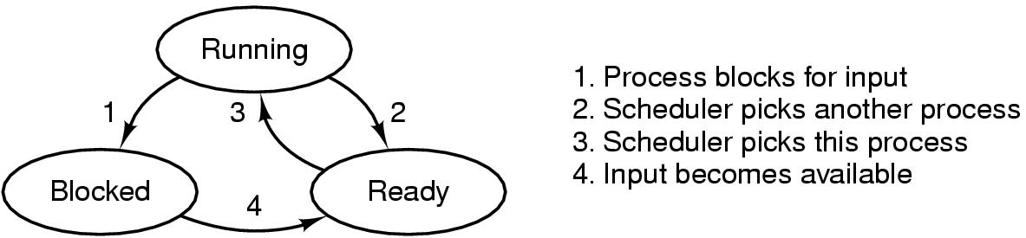
Process States
A process can be in running, blocked, or ready state. Transitions between these states are as shown.
Tanenbaum, Modern Operating Systems 3 e, (c) 2008 Prentice-Hall, Inc. All rights reserved. 0-13-6006639

Slide 7
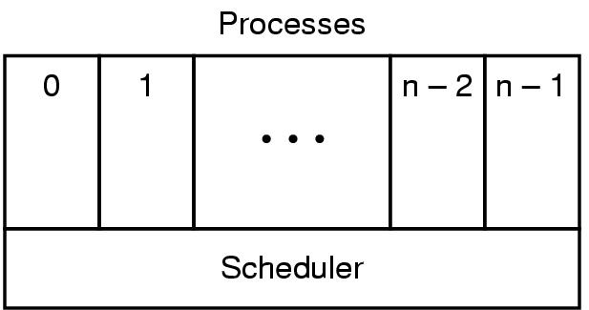
Implementation of Processes (1)
The lowest layer of a process-structured operating system handles interrupts and scheduling. Above that layer are sequential processes.
Tanenbaum, Modern Operating Systems 3 e, (c) 2008 Prentice-Hall, Inc. All rights reserved. 0-13-6006639

Slide 8
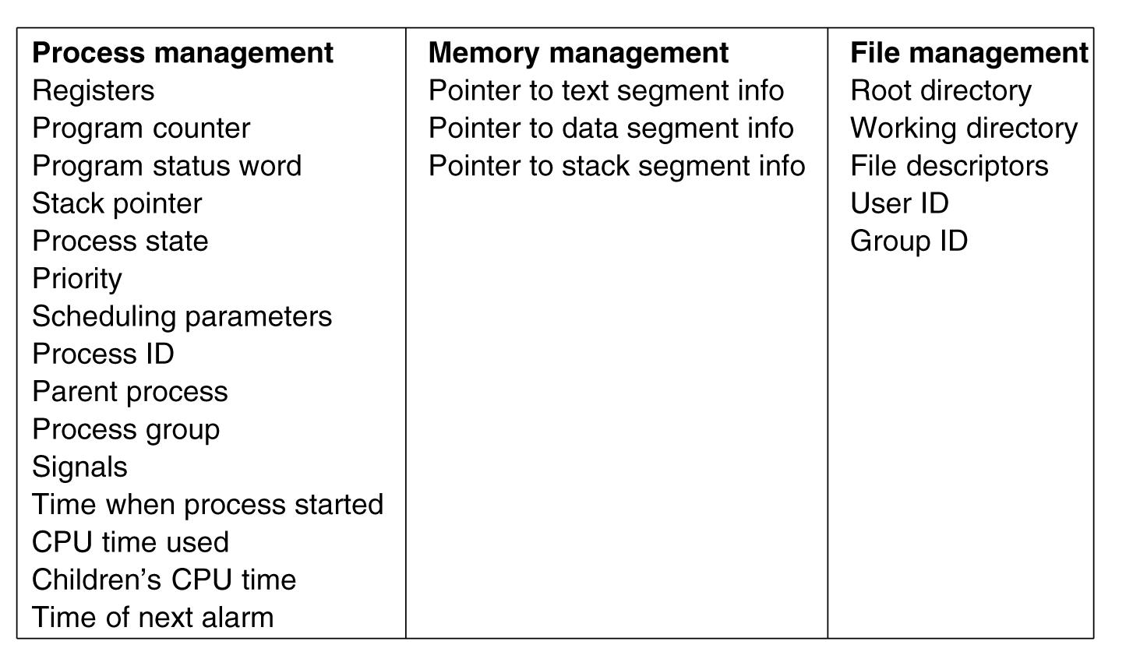
Implementation of Processes (2)
Some of the fields of a typical process table entry.
Tanenbaum, Modern Operating Systems 3 e, (c) 2008 Prentice-Hall, Inc. All rights reserved. 0-13-6006639

Slide 9
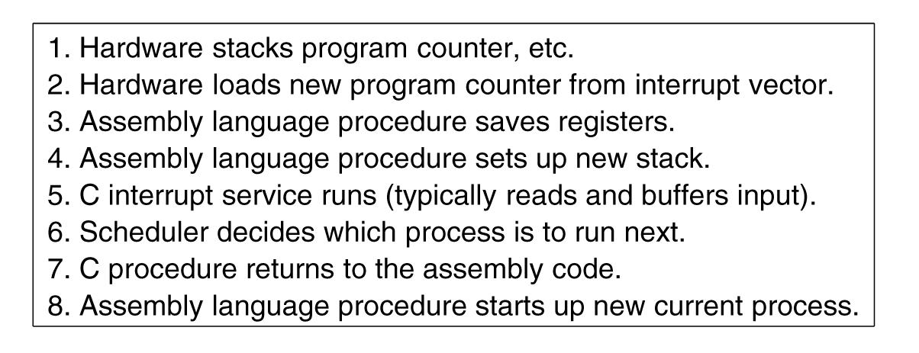
OS processes an interrupt
Skeleton of what the lowest level of the operating system does when an interrupt occurs.
Tanenbaum, Modern Operating Systems 3 e, (c) 2008 Prentice-Hall, Inc. All rights reserved. 0-13-6006639

Slide 10
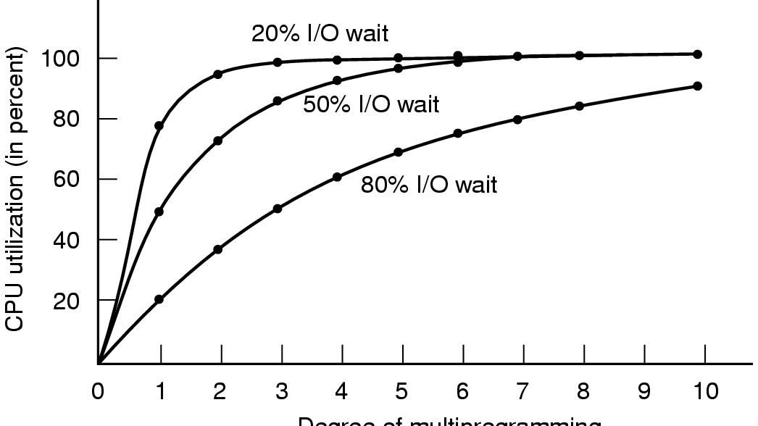
How multiprogramming performs
CPU utilization as a function of the number of processes in memory.
Tanenbaum, Modern Operating Systems 3 e, (c) 2008 Prentice-Hall, Inc. All rights reserved. 0-13-6006639

Slide 11

Thread Example-web server
.
.
Tanenbaum, Modern Operating Systems 3 e, (c) 2008 Prentice-Hall, Inc. All rights reserved. 0-13-6006639

Slide 12
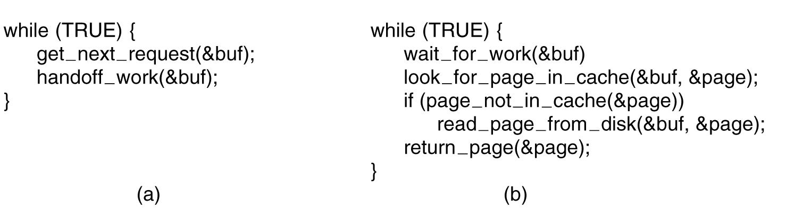
Web server code
(a) Dispatcher thread. (b) Worker thread.
Tanenbaum, Modern Operating Systems 3 e, (c) 2008 Prentice-Hall, Inc. All rights reserved. 0-13-6006639

Slide 13
Web server
If page is not there, then thread blocks
CPU does nothing while it waits for page
Thread structure enables server to instantiate another page and get something done
Tanenbaum, Modern Operating Systems 3 e, (c) 2008 Prentice-Hall, Inc. All rights reserved. 0-13-6006639

Slide 14
Another way to do the same thing-finite state machine
If page is not there, use a non-blocking call
When thread returns page send interrupt to CPU, (signal)
Causes process context switch (expensive)
Tanenbaum, Modern Operating Systems 3 e, (c) 2008 Prentice-Hall, Inc. All rights reserved. 0-13-6006639

Slide 15
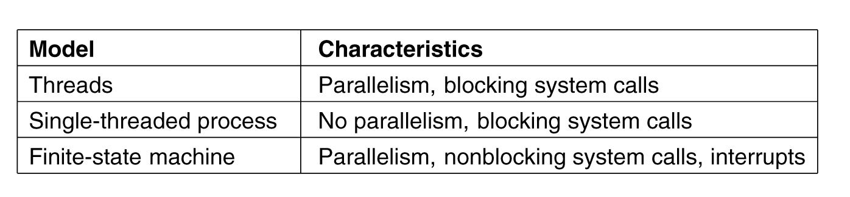
Three ways to build the server
Tanenbaum, Modern Operating Systems 3 e, (c) 2008 Prentice-Hall, Inc. All rights reserved. 0-13-6006639

Slide 16
Reasons to use threads
Enables parallelism (web server) with blocking system calls
Threads are faster to create and destroy then processes
Natural for multiple cores
Easy programming model
Tanenbaum, Modern Operating Systems 3 e, (c) 2008 Prentice-Hall, Inc. All rights reserved. 0-13-6006639

Slide 17
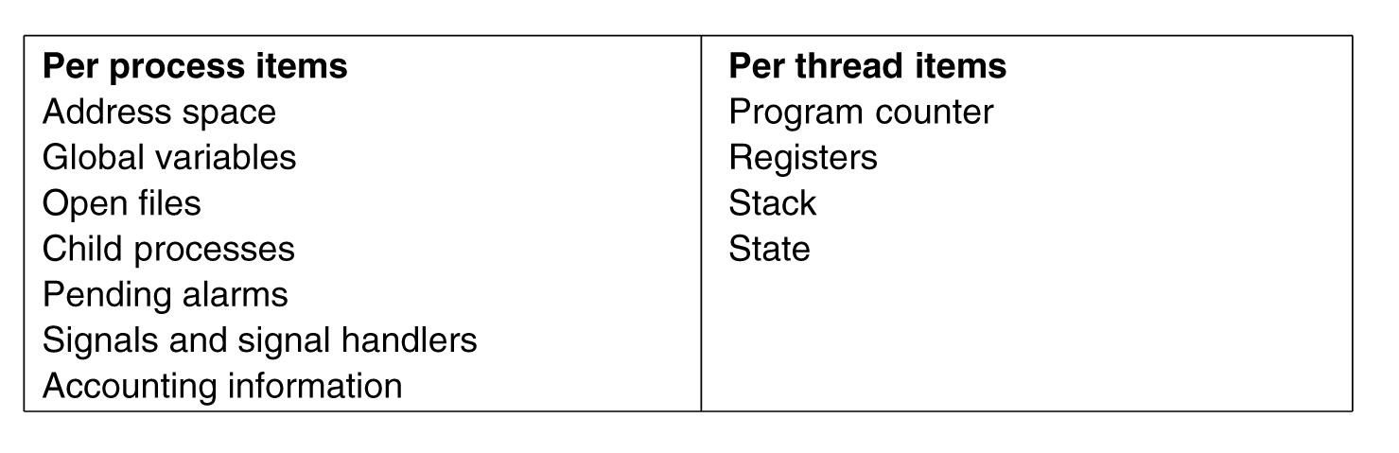
Threads are lightweight
Tanenbaum, Modern Operating Systems 3 e, (c) 2008 Prentice-Hall, Inc. All rights reserved. 0-13-6006639

Slide 18
Threads are like processes
Have same states
  Running
  Ready
  Blocked
Have their own stacks –same as processes
Stacks contain frames for (un-returned) procedure calls
  Local variables
  Return address to use when procedure comes back
Tanenbaum, Modern Operating Systems 3 e, (c) 2008 Prentice-Hall, Inc. All rights reserved. 0-13-6006639

Slide 19
How do threads work?
Start with one thread in a process
Thread contains (id, registers, attributes)
Use library call to create new threads and to use threads
  Thread_create includes parameter indicating what procedure to run
  Thread_exit causes thread to exit and disappear (can’t schedule it)
  Thread_join Thread blocks until another thread finishes its work
  Thread_yield

Slide 20
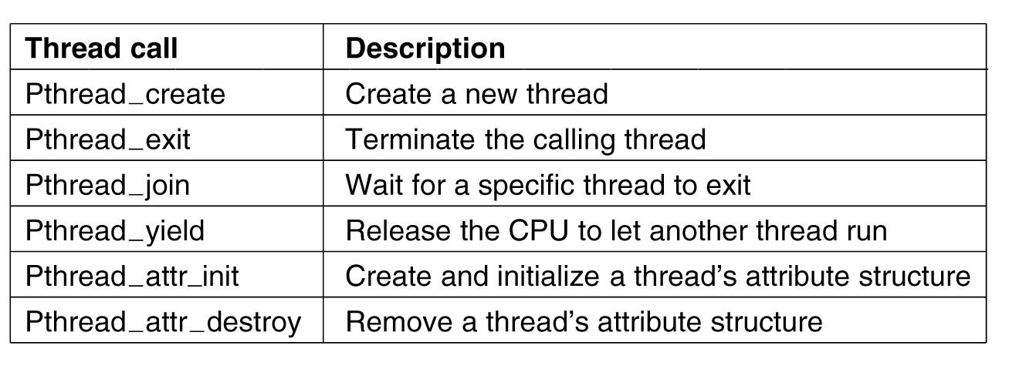
POSIX Threads (Pthreads)
Pthreads are IEEE Unix standard library calls
Tanenbaum, Modern Operating Systems 3 e, (c) 2008 Prentice-Hall, Inc. All rights reserved. 0-13-6006639

Slide 21
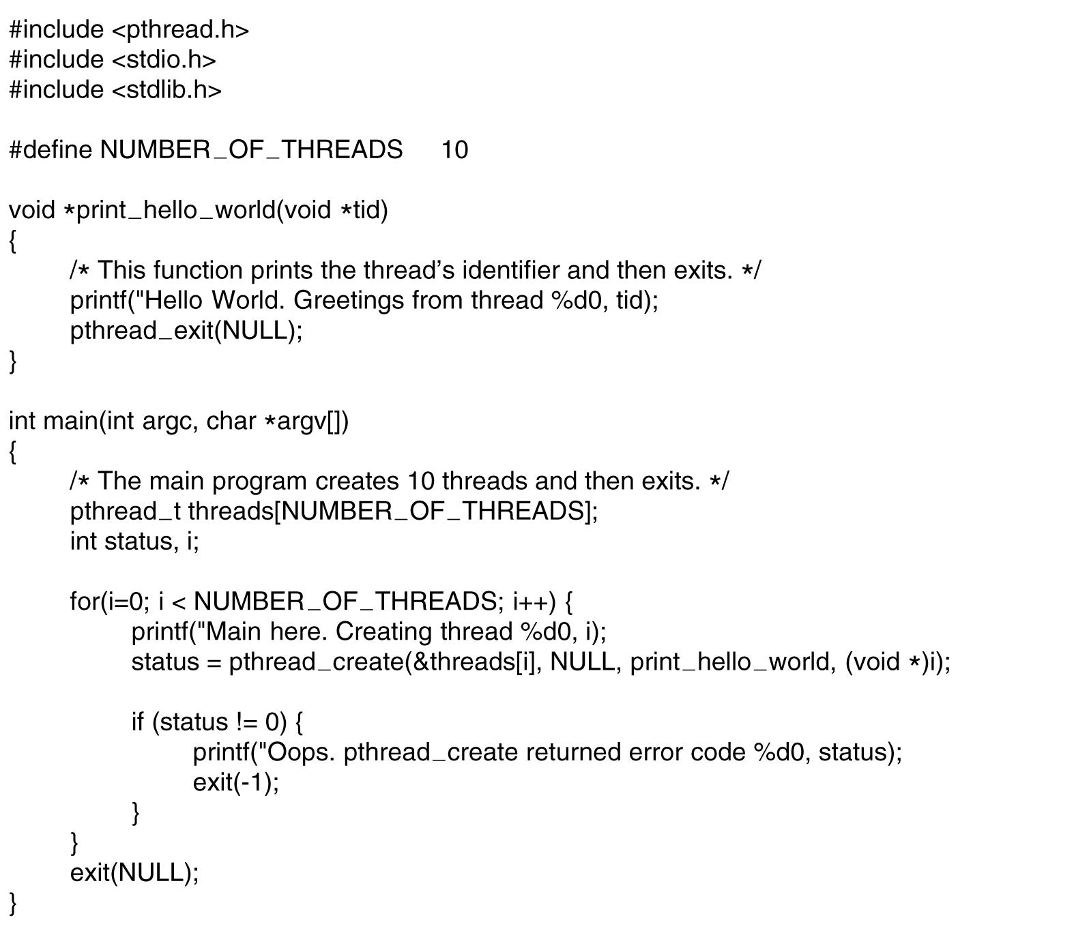
A Pthreads example-”Hello,world”
. . .
.
Tanenbaum, Modern Operating Systems 3 e, (c) 2008 Prentice-Hall, Inc. All rights reserved. 0-13-6006639

Slide 22
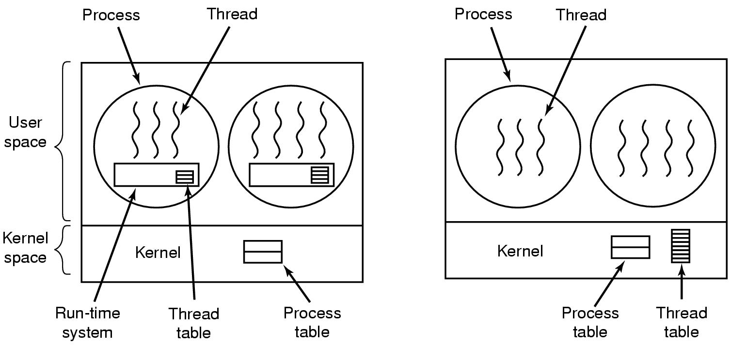
Implementing Threads in User Space
(a) A user-level threads package. (b) A threads package managed by the kernel.
Tanenbaum, Modern Operating Systems 3 e, (c) 2008 Prentice-Hall, Inc. All rights reserved. 0-13-6006639

Slide 23
Threads in user space-the good
Thread table contains info about threads (program counter, stack pointer...) so that run time system can manage them
If thread blocks, run time system stores thread info in table and finds new thread to run.
State save and scheduling are invoked faster then kernel call (no trap, no cache flush)
Tanenbaum, Modern Operating Systems 3 e, (c) 2008 Prentice-Hall, Inc. All rights reserved. 0-13-6006639

Slide 24
Threads in user space-the bad
Can’t let thread execute system call which blocks because it will block all of the other threads
No elegant solution
  Hack system library to avoid blocking calls
  Could use select system calls-in some versions of Unix which do same thing
Threads don’t voluntarily give up CPU
  Could interrupt periodically to give control to run time system
  Overhead of this solution is a problem…..
Tanenbaum, Modern Operating Systems 3 e, (c) 2008 Prentice-Hall, Inc. All rights reserved. 0-13-6006639

Slide 25
Threads in kernel space-the good
Kernel keeps same thread table as user table
If thread blocks, kernel just picks another one
  Not necessarily from same process!
The bad-expensive to manage the threads in the kernel and takes valuable kernel space
Tanenbaum, Modern Operating Systems 3 e, (c) 2008 Prentice-Hall, Inc. All rights reserved. 0-13-6006639

Slide 26
Threads in kernel space-the bad
Expensive to manage the threads in the kernel and takes valuable kernel space
How do we get the advantages of both approaches, without the disadvantages?
Tanenbaum, Modern Operating Systems 3 e, (c) 2008 Prentice-Hall, Inc. All rights reserved. 0-13-6006639

Slide 27
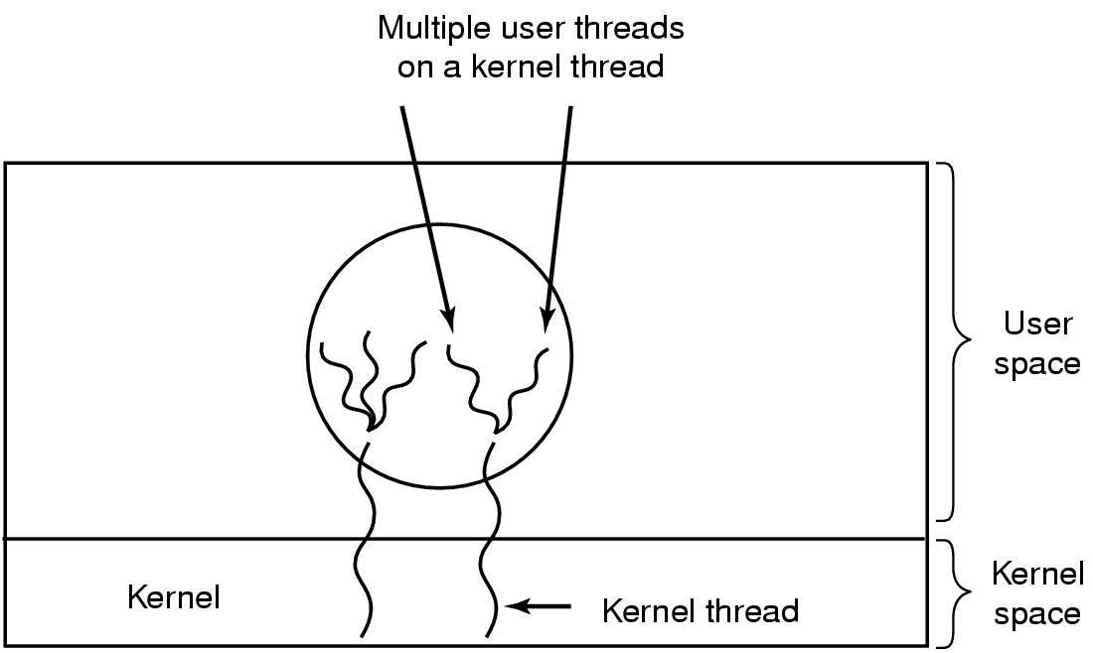
Hybrid approach
Multiplex user-level threads onto kernel level threads
Tanenbaum, Modern Operating Systems 3 e, (c) 2008 Prentice-Hall, Inc. All rights reserved. 0-13-6006639

Slide 28
Hybrid
Kernel is aware of kernel threads only
User level threads are scheduled, created destroyed independently of kernel thread
Programmer determines how many user level and how many kernel level threads to use
Tanenbaum, Modern Operating Systems 3 e, (c) 2008 Prentice-Hall, Inc. All rights reserved. 0-13-6006639

Slide 29
Scheduler activations-Upcalls
Want the run time system to switch threads when a thread blocks
  Associate a virtual processor with each process
  Run time system allocates threads to virtual processors
Kernel notifies the run time system that
  a thread has blocked
  passes info to RTS (thread id…)
  RTS schedules another thread
Tanenbaum, Modern Operating Systems 3 e, (c) 2008 Prentice-Hall, Inc. All rights reserved. 0-13-6006639
Notes:
This offends the religious zealots because it violates layering

Slide 30
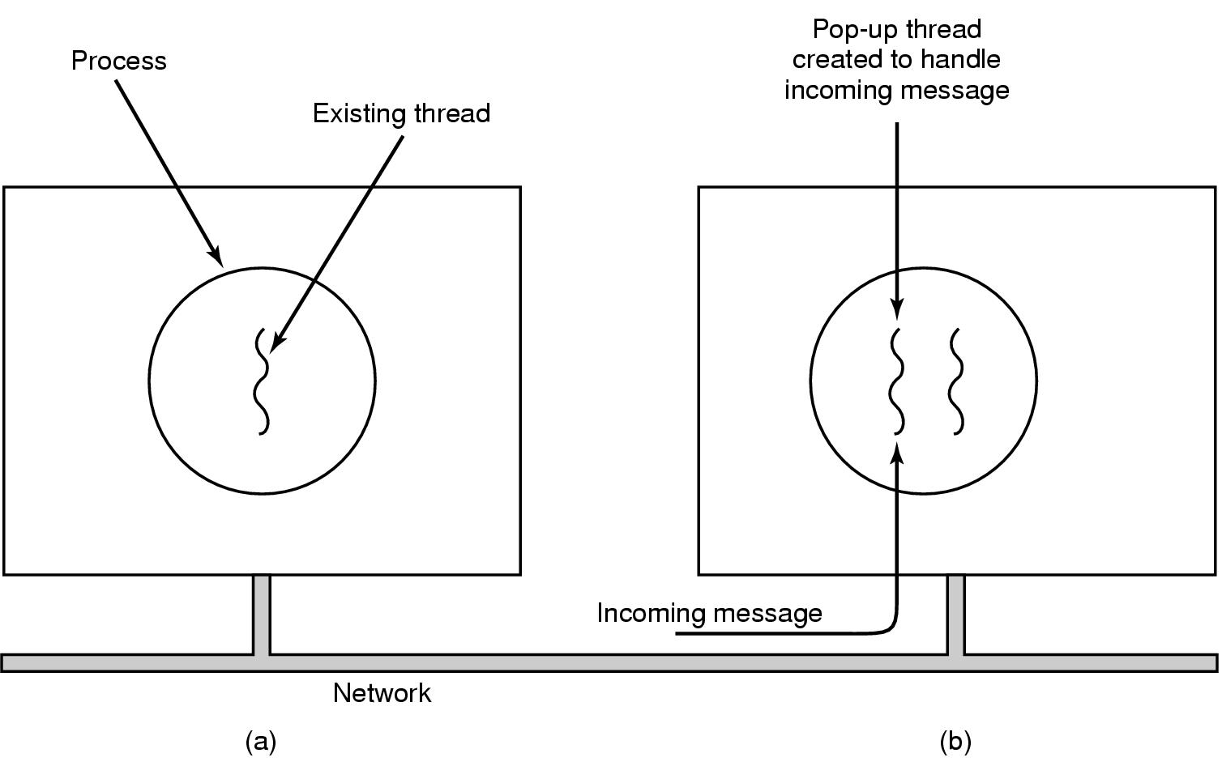
Pop-Up Threads
(How to handle message arrivals in distributed systems)
Create a new thread when a message arrives
Tanenbaum, Modern Operating Systems 3 e, (c) 2008 Prentice-Hall, Inc. All rights reserved. 0-13-6006639

Slide 31
Why pop ups?
Could use thread which blocks on a receive system call and processes messages when they arrive
Means that you have to restore the history of the thread each time a message arrives
Pop ups are entirely new-nothing to restore
They are faster
Tanenbaum, Modern Operating Systems 3 e, (c) 2008 Prentice-Hall, Inc. All rights reserved. 0-13-6006639

Slide 32
Adding threads to an OS-problems
How do we implement variables which should be global to a thread but not to the entire program?
Example: Thread wants access to a file, Unix grants access via global errno
Race ensues-thread 1 can get the wrong permission because thread 2 over-writes it
Tanenbaum, Modern Operating Systems 3 e, (c) 2008 Prentice-Hall, Inc. All rights reserved. 0-13-6006639

Slide 33
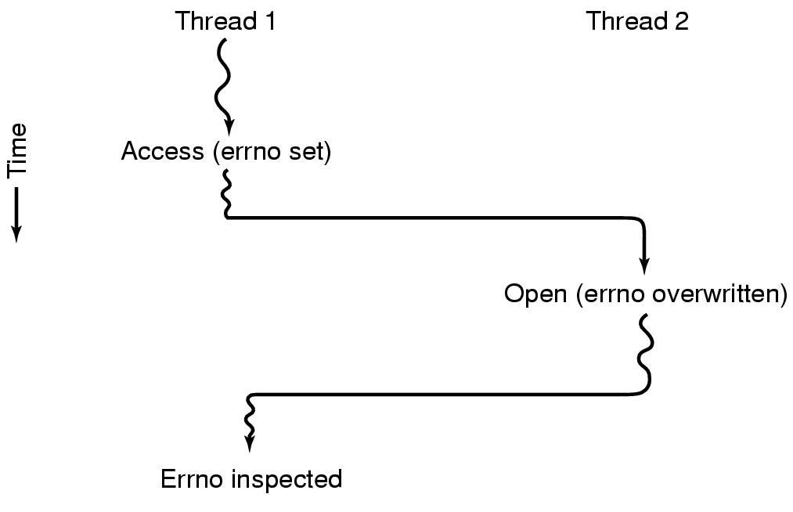
Thread 1 gets the wrong permission
Tanenbaum, Modern Operating Systems 3 e, (c) 2008 Prentice-Hall, Inc. All rights reserved. 0-13-6006639

Slide 34
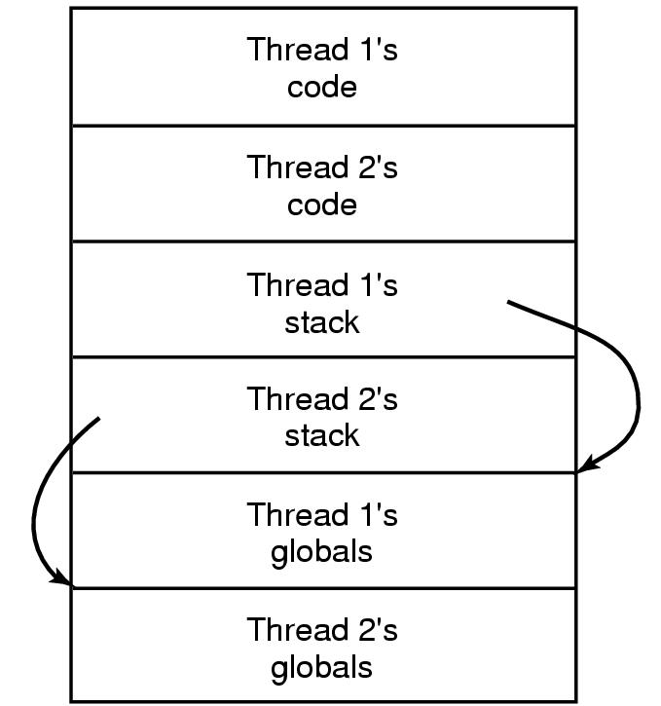
Solution-Create private global variables
Tanenbaum, Modern Operating Systems 3 e, (c) 2008 Prentice-Hall, Inc. All rights reserved. 0-13-6006639

Slide 35
How?
Could use library routines to create, set and read globals.
Global is then unique to each thread
Tanenbaum, Modern Operating Systems 3 e, (c) 2008 Prentice-Hall, Inc. All rights reserved. 0-13-6006639

Slide 36
More problems
Library routine which is not re-entrant.
  Eg. Sending a message-one thread puts message in a buffer, new thread appears and over-writes message
Memory allocation programs may be (temporarily) in an inconsistent state
  Eg. New thread gets wrong pointer
Hard do we implement signals which are thread specific ?
  If threads are in user space, kernel can’t address right thread.
Tanenbaum, Modern Operating Systems 3 e, (c) 2008 Prentice-Hall, Inc. All rights reserved. 0-13-6006639

Slide 37
MORAL OF THE STORY
Need to re-work the semantics of system calls and library routines in order to add threads to a system

Slide 38
Interprocess Communication
Three problems
    How to actually do it
    How to deal with process conflicts (2 airline reservations for same seat)
    How to do correct sequencing when dependencies are present-aim the gun before firing it
SAME ISSUES FOR THREADS AS FOR PROCESSES-SAME SOLUTIONS AS WELL
Proceed to discuss these problems
.
Tanenbaum, Modern Operating Systems 3 e, (c) 2008 Prentice-Hall, Inc. All rights reserved. 0-13-6006639

Slide 39

Race Conditions
In is local variable containing pointer to next free slot
Out is local variable pointing to next file to be printed
Tanenbaum, Modern Operating Systems 3 e, (c) 2008 Prentice-Hall, Inc. All rights reserved. 0-13-6006639
Notes:
Printer daemon prints processes and spooler directory contains files

Slide 40
How to avoid races
Mutual exclusion–only one process at a time can use a shared variable/file
Critical regions-shared memory which leads to races
Solution- Ensure that two processes can’t be in the critical region at the same time
.
Tanenbaum, Modern Operating Systems 3 e, (c) 2008 Prentice-Hall, Inc. All rights reserved. 0-13-6006639

Slide 41
Properties of a good solution
Mutual exclusion
No assumptions about speeds or number of CPU’s
No process outside critical region can block other processes
No starvation-no process waits forever to enter critical region
.
Tanenbaum, Modern Operating Systems 3 e, (c) 2008 Prentice-Hall, Inc. All rights reserved. 0-13-6006639

Slide 42

What we are trying to do
Tanenbaum, Modern Operating Systems 3 e, (c) 2008 Prentice-Hall, Inc. All rights reserved. 0-13-6006639

Slide 43
First attempts-Busy Waiting
A laundry list of proposals to achieve mutual exclusion
Disabling interrupts
Lock variables
Strict alternation
Peterson's solution
The TSL instruction
Tanenbaum, Modern Operating Systems 3 e, (c) 2008 Prentice-Hall, Inc. All rights reserved. 0-13-6006639

Slide 44
Disabling Interrupts
Idea: process disables interrupts, enters cr, enables interrupts when it leaves cr
Problems
  Process might never enable interrupts, crashing system
  Won’t work on multi-core chips as disabling interrupts only effects one CPU at a time
Tanenbaum, Modern Operating Systems 3 e, (c) 2008 Prentice-Hall, Inc. All rights reserved. 0-13-6006639

Slide 45
Lock variables
A software solution-everyone shares a lock
  When lock is 0, process turns it to 1 and enters cr
  When exit cr, turn lock to 0
Problem-Race condition
Tanenbaum, Modern Operating Systems 3 e, (c) 2008 Prentice-Hall, Inc. All rights reserved. 0-13-6006639

Slide 46
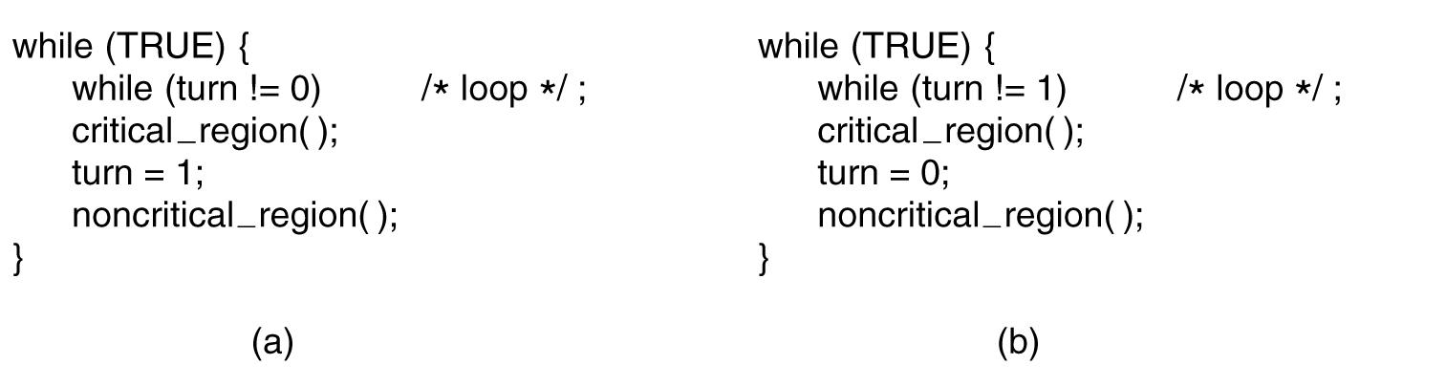
Strict Alternation
First me, then you
Tanenbaum, Modern Operating Systems 3 e, (c) 2008 Prentice-Hall, Inc. All rights reserved. 0-13-6006639

Slide 47
Problems with strict alternation
Employs busy waiting-while waiting for the cr, a process spins
If one process is outside the cr and it is its turn, then other process has to wait until outside guy finishes both outside AND inside (cr) work
Tanenbaum, Modern Operating Systems 3 e, (c) 2008 Prentice-Hall, Inc. All rights reserved. 0-13-6006639

Slide 48
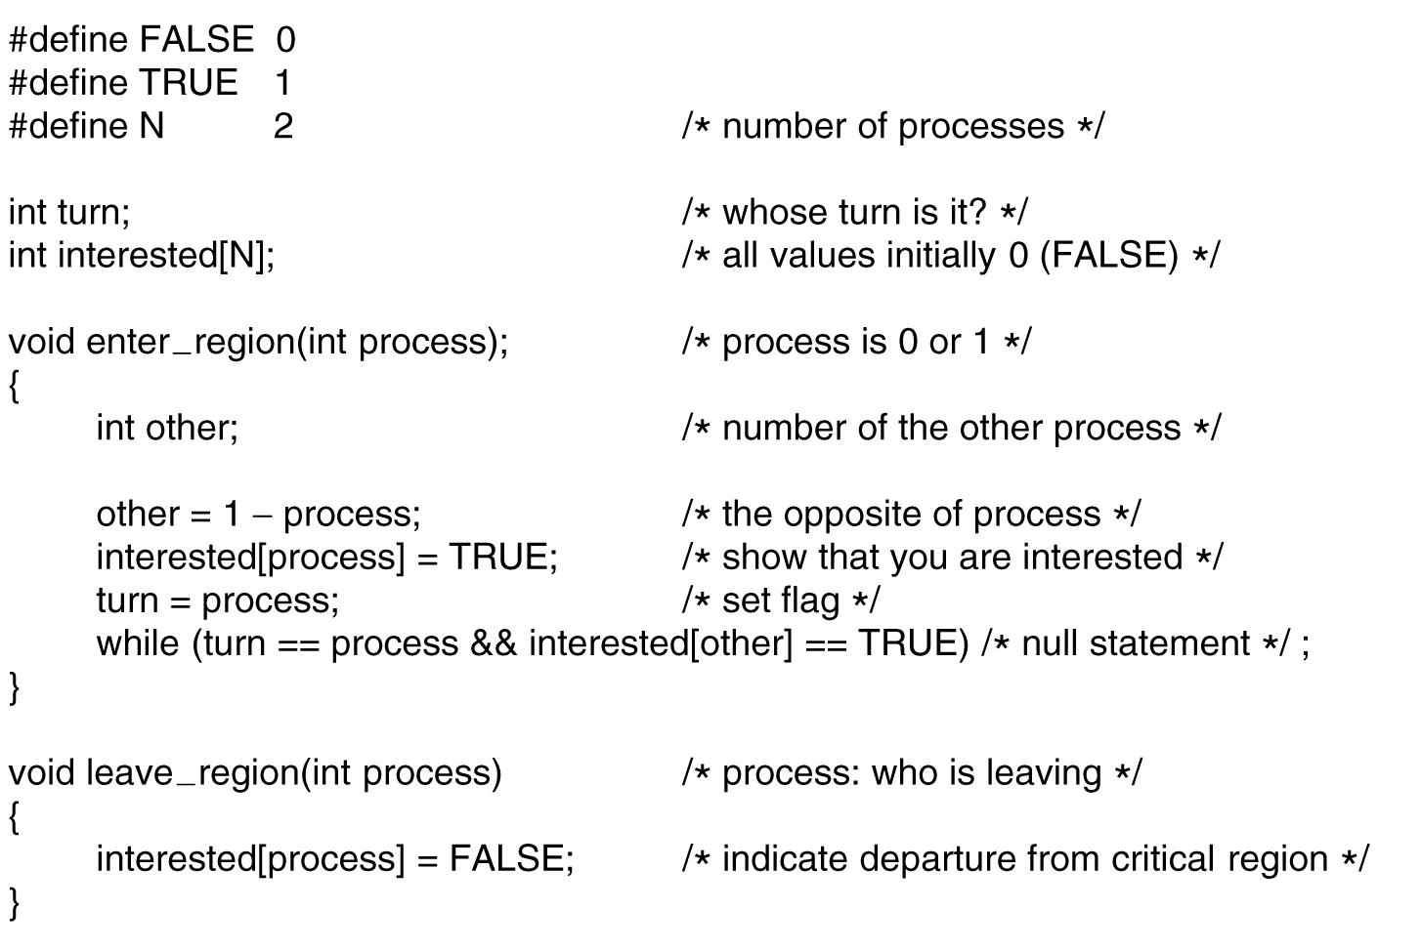
Peterson's Solution
.
Tanenbaum, Modern Operating Systems 3 e, (c) 2008 Prentice-Hall, Inc. All rights reserved. 0-13-6006639

Slide 49
Peterson
Process 0 & 1 try to get in simultaneously
Last one in sets turn: say it is process 1
Process 0 enters (turn= = process is False)
Tanenbaum, Modern Operating Systems 3 e, (c) 2008 Prentice-Hall, Inc. All rights reserved. 0-13-6006639

Slide 50
TSL
TSL reads lock into register and stores NON ZERO VALUE in lock (e.g. process number)
Instruction is atomic: done by freezing access to bus line (bus disable)
Tanenbaum, Modern Operating Systems 3 e, (c) 2008 Prentice-Hall, Inc. All rights reserved. 0-13-6006639

Slide 51
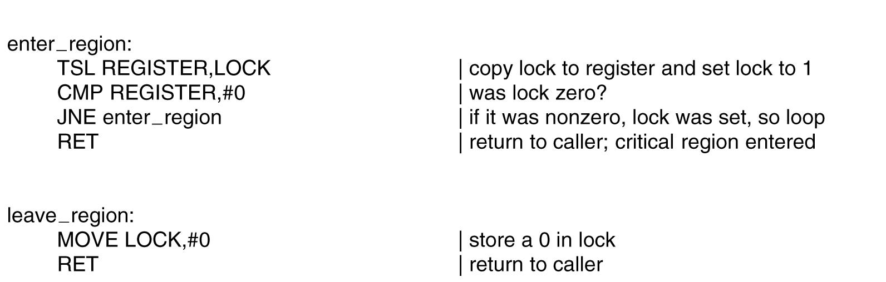
Using TSL
TSL is atomic. Memory bus is locked until it is finished executing.
Tanenbaum, Modern Operating Systems 3 e, (c) 2008 Prentice-Hall, Inc. All rights reserved. 0-13-6006639

Slide 52
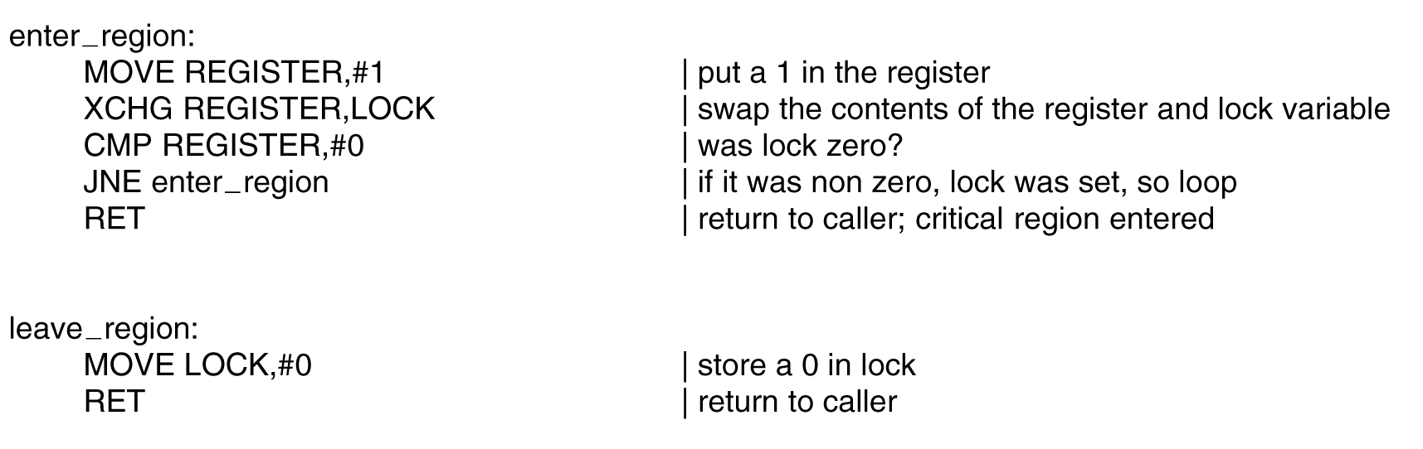
XCHG instruction
Xchg a,b exchanges a & b
Tanenbaum, Modern Operating Systems 3 e, (c) 2008 Prentice-Hall, Inc. All rights reserved. 0-13-6006639

Slide 53
What’s wrong with Peterson, TSL ,XCHG?
Busy waiting-waste of CPU time!
Idea: Replace busy waiting by blocking calls
  Sleep blocks process
  Wakeup unblocks process
Tanenbaum, Modern Operating Systems 3 e, (c) 2008 Prentice-Hall, Inc. All rights reserved. 0-13-6006639

Slide 54
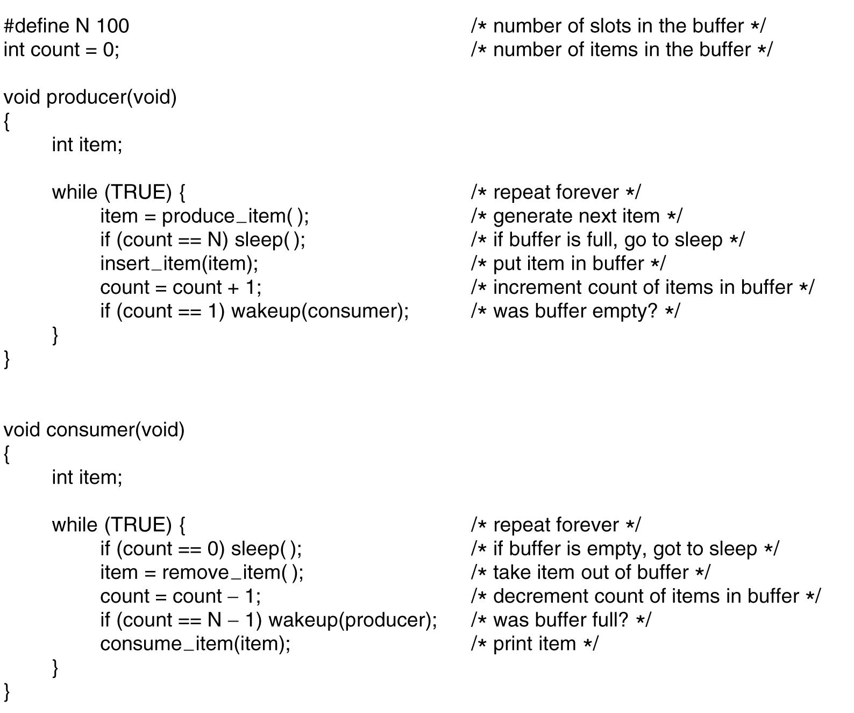
The Producer-Consumer Problem (aka Bounded Buffer Problem)
. . .
Tanenbaum, Modern Operating Systems 3 e, (c) 2008 Prentice-Hall, Inc. All rights reserved. 0-13-6006639

Slide 55
The problem with sleep and wake-up calls
Empty buffer,count==0
Consumer gets replaced by producer before it goes to sleep
Produces something, count++, sends wakeup to consumer
Consumer not asleep, ignores wakeup, thinks count= = 0, goes to sleep
Producer fills buffer, goes to sleep
P and C sleep forever
So the problem is lost wake-up calls
Tanenbaum, Modern Operating Systems 3 e, (c) 2008 Prentice-Hall, Inc. All rights reserved. 0-13-6006639

Slide 56
P kisses C, who becomes a prince. All is well.

Slide 57
Semaphores
Semaphore is an integer variable
Used to sleeping processes/wakeups
Two operations, down and up
Down checks semaphore. If not zero, decrements semaphore. If zero, process goes to sleep
Up increments semaphore. If more then one process asleep, one is chosen randomly and enters critical region (first does a down)
ATOMIC IMPLEMENTATION-interrupts disabled
Tanenbaum, Modern Operating Systems 3 e, (c) 2008 Prentice-Hall, Inc. All rights reserved. 0-13-6006639

Slide 58
Producer Consumer with Semaphores
3 semaphores: full, empty and mutex
Full counts full slots (initially 0)
Empty counts empty slots (initially N)
Mutex protects variable which contains the items produced and consumed
Tanenbaum, Modern Operating Systems 3 e, (c) 2008 Prentice-Hall, Inc. All rights reserved. 0-13-6006639

Slide 59
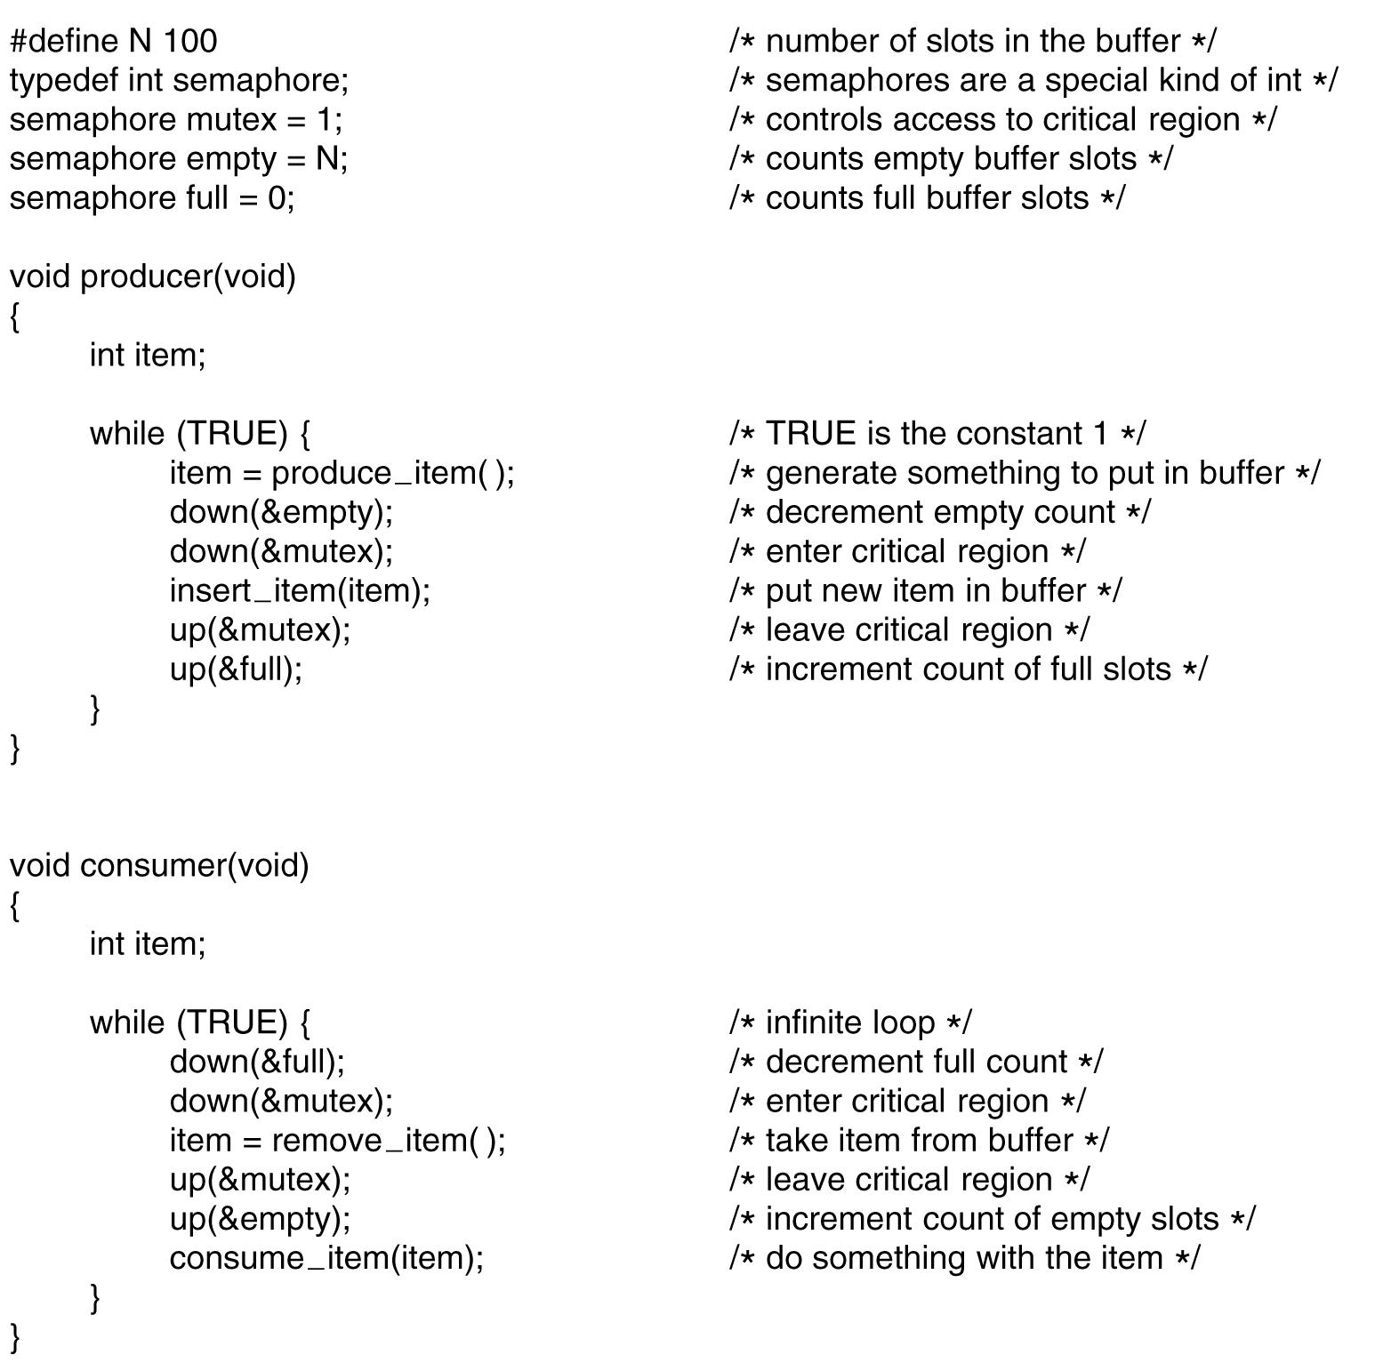
Producer Consumer with semaphores
. . .
Tanenbaum, Modern Operating Systems 3 e, (c) 2008 Prentice-Hall, Inc. All rights reserved. 0-13-6006639

Slide 60
Mutexes
Don’t always need counting operation of semaphore, just mutual exclusion part
Mutex: variable which can be in one of two states-locked (0), unlocked(1 or other value)
  Easy to implement
Good for using with thread packages in user space
  Thread (process) wants access to cr, calls mutex_lock.
  If mutex is unlocked, call succeeds. Otherwise, thread blocks until thread in the cr does a mutex_unlock.
Tanenbaum, Modern Operating Systems 3 e, (c) 2008 Prentice-Hall, Inc. All rights reserved. 0-13-6006639

Slide 61
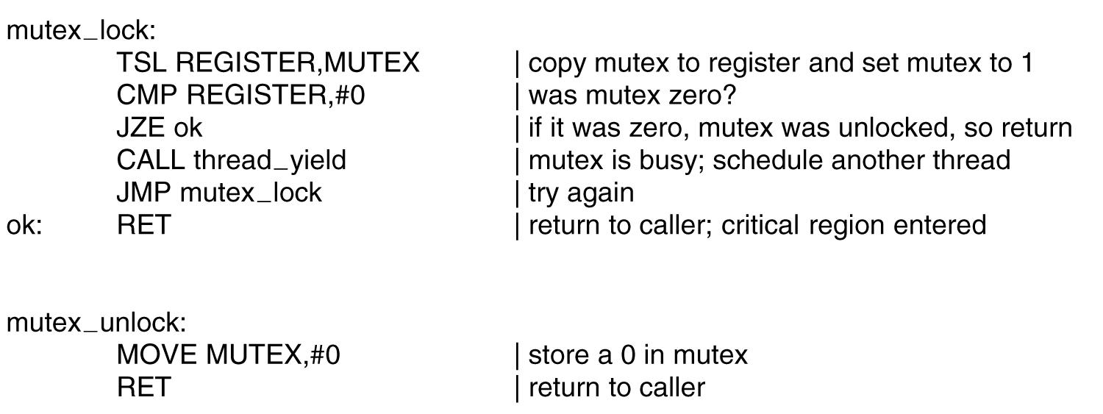
Mutexes
User space code for mutex lock and unlock
Tanenbaum, Modern Operating Systems 3 e, (c) 2008 Prentice-Hall, Inc. All rights reserved. 0-13-6006639

Slide 62
More Mutex
Enter region code for TSL results in busy waiting (process keeps testing lock)
  Clock runs out, process is bumped from CPU
No clock for threads => spinning thread could wait forever =>need to get spinner out of there
Use thread_yield to give up the CPU to another thread.
  Thread yield is fast (in user space).
  No kernel calls needed for mutex_lock or mutex_unlock.
Tanenbaum, Modern Operating Systems 3 e, (c) 2008 Prentice-Hall, Inc. All rights reserved. 0-13-6006639

Slide 63
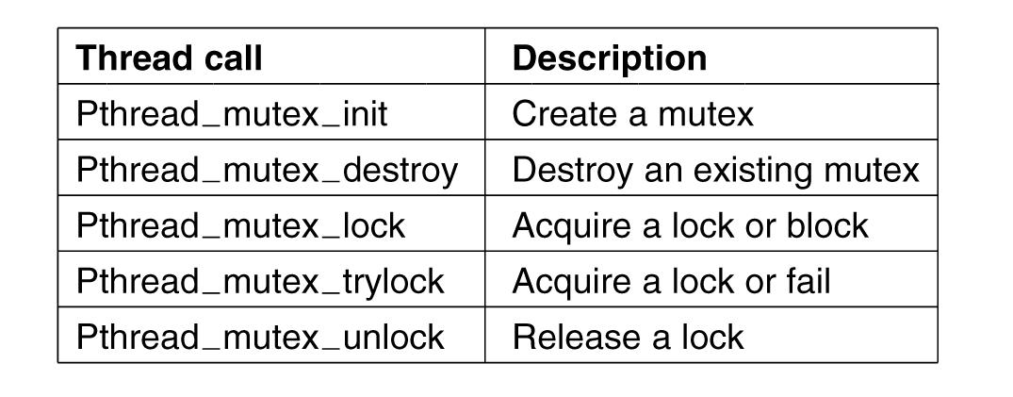
Pthread calls for mutexes
Pthread_mutex-trylock tries to lock mutex. If it fails it returns an error code, and can do something else.
Tanenbaum, Modern Operating Systems 3 e, (c) 2008 Prentice-Hall, Inc. All rights reserved. 0-13-6006639

Slide 64
Condition Variables
Allows a thread to block if a condition is not met, e.g. Producer-Consumer. Producer needs to block if the buffer is full.
Mutex make it possible to check if buffer is full
Condition variable makes it possible to put producer to sleep if buffer is full
Both are present in pthreads and are used together
Tanenbaum, Modern Operating Systems 3 e, (c) 2008 Prentice-Hall, Inc. All rights reserved. 0-13-6006639

Slide 65
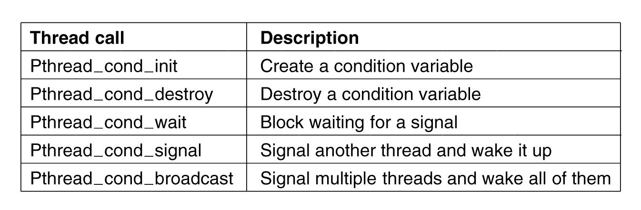
Pthread Condition Variable calls
Tanenbaum, Modern Operating Systems 3 e, (c) 2008 Prentice-Hall, Inc. All rights reserved. 0-13-6006639

Slide 66
Producer Consumer with condition variables and mutexes
Producer produces one item and blocks waiting for consumer to use the item
Signals consumer that the item has been produced
Consumer blocks waiting for producer to signal that item is in buffer
Consumer consumes item, signals producer to produce new item
Tanenbaum, Modern Operating Systems 3 e, (c) 2008 Prentice-Hall, Inc. All rights reserved. 0-13-6006639

Slide 67
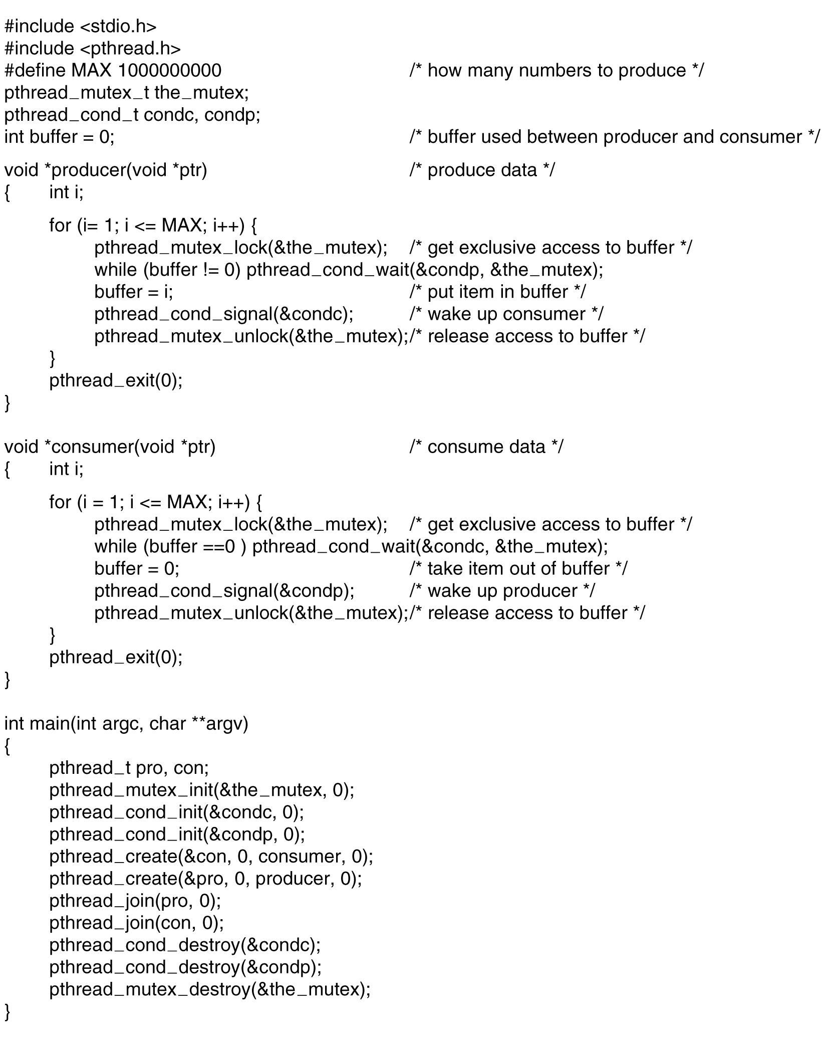
Producer Consumer with condition variables
. . .
.
Tanenbaum, Modern Operating Systems 3 e, (c) 2008 Prentice-Hall, Inc. All rights reserved. 0-13-6006639

Slide 68
Monitors
Easy to make a mess of things using mutexes and condition variables. Little errors cause disasters.
  Producer consumer with semaphores- interchange two downs in producer code causes deadlock
Monitor is a language construct which enforces mutual exclusion and blocking mechanism
C does not have monitor
Tanenbaum, Modern Operating Systems 3 e, (c) 2008 Prentice-Hall, Inc. All rights reserved. 0-13-6006639

Slide 69
Monitors
Monitor consists of {procedures, data structures, and variables} grouped together in a “module”
A process can call procedures inside the monitor, but cannot directly access the stuff inside the monitor
C does not have monitors
Tanenbaum, Modern Operating Systems 3 e, (c) 2008 Prentice-Hall, Inc. All rights reserved. 0-13-6006639

Slide 70
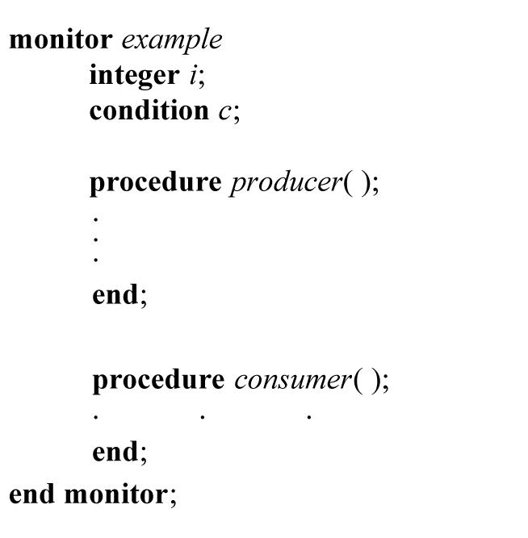
Monitor-a picture
Tanenbaum, Modern Operating Systems 3 e, (c) 2008 Prentice-Hall, Inc. All rights reserved. 0-13-6006639

Slide 71
Onwards
In a monitor it is the job of the compiler, not the programmer to enforce mutual exclusion.
Only one process at a time can be in the monitor
  When a process calls a monitor, the first thing done is to check if another process is in the monitor. If so, calling process is suspended.
Need to enforce blocking as well –
  use condition variables
  Use wait , signal ops on cv’s
Tanenbaum, Modern Operating Systems 3 e, (c) 2008 Prentice-Hall, Inc. All rights reserved. 0-13-6006639

Slide 72
Condition Variables
Monitor discovers that it can’t continue (e.g. buffer is full), issues a signal on a condition variable (e.g. full) causing process (e.g. producer) to block
Another process is allowed to enter the monitor (e.g. consumer).This process can can issue a signal, causing blocked process (producer) to wake up
Process issuing signal leaves monitor
Tanenbaum, Modern Operating Systems 3 e, (c) 2008 Prentice-Hall, Inc. All rights reserved. 0-13-6006639

Slide 73
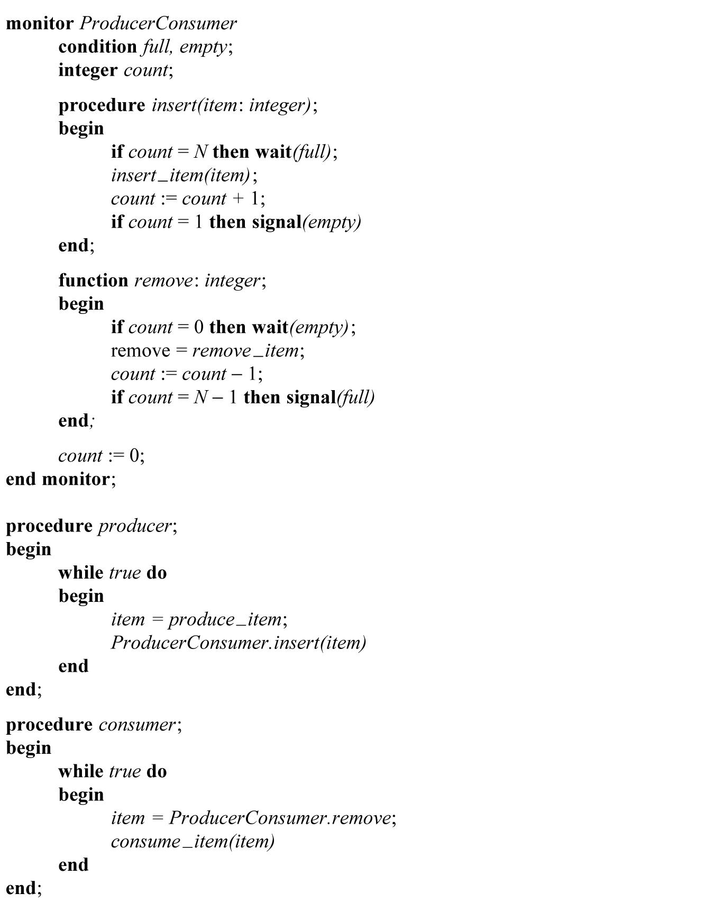
Producer Consumer Monitor
Tanenbaum, Modern Operating Systems 3 e, (c) 2008 Prentice-Hall, Inc. All rights reserved. 0-13-6006639

Slide 74
Monitors:Good vs Bad
The good-No messy direct programmer control of semaphores
The bad- You need a language which supports monitors (Java).
OS’s are written in C
Tanenbaum, Modern Operating Systems 3 e, (c) 2008 Prentice-Hall, Inc. All rights reserved. 0-13-6006639

Slide 75
Semaphores:Good vs Bad
The good-Easy to implement
The bad- Easy to mess up
Tanenbaum, Modern Operating Systems 3 e, (c) 2008 Prentice-Hall, Inc. All rights reserved. 0-13-6006639

Slide 76
Reality
Monitors and semaphores only work for shared memory
Don’t work for multiple CPU’s which have their own private memory, e.g. workstations on an Ethernet
Tanenbaum, Modern Operating Systems 3 e, (c) 2008 Prentice-Hall, Inc. All rights reserved. 0-13-6006639

Slide 77
Message Passing
Information exchange between machines
Two primitives
  Send(destination, &message)
  Receive(source,&message)
Lots of design issues
  Message loss
    acknowledgements, time outs deal with loss
  Authentication-how does a process know the identity of the sender? For sure, that is
Tanenbaum, Modern Operating Systems 3 e, (c) 2008 Prentice-Hall, Inc. All rights reserved. 0-13-6006639

Slide 78
Producer Consumer Using Message Passing
Consumer sends N empty messages to producer
Producer fills message with data and sends to consumer
Tanenbaum, Modern Operating Systems 3 e, (c) 2008 Prentice-Hall, Inc. All rights reserved. 0-13-6006639

Slide 79
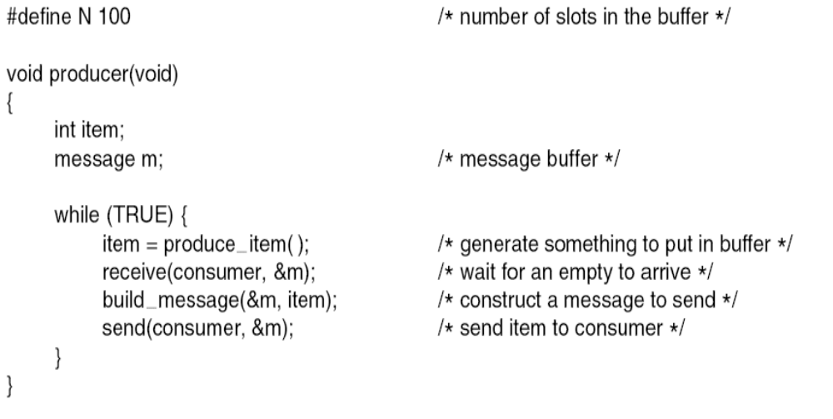
Producer-Consumer Problem
with Message Passing (1)
. . .
.
Tanenbaum, Modern Operating Systems 3 e, (c) 2008 Prentice-Hall, Inc. All rights reserved. 0-13-6006639

Slide 80
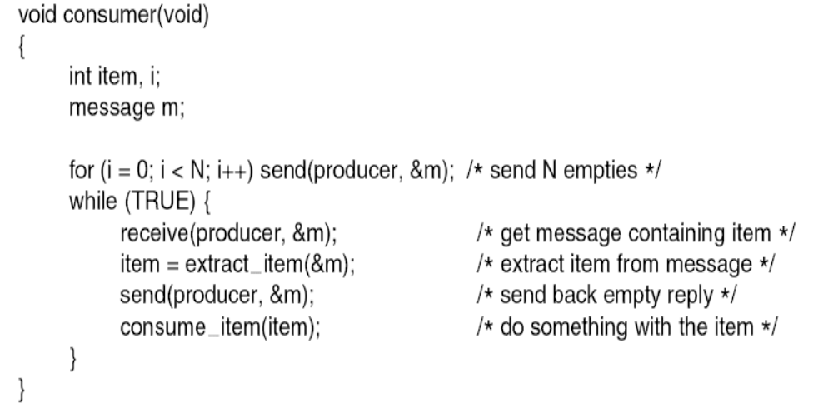
Producer-Consumer Problem
with Message Passing (2)
. . .
Tanenbaum, Modern Operating Systems 3 e, (c) 2008 Prentice-Hall, Inc. All rights reserved. 0-13-6006639

Slide 81
Message Passing Approaches
Have unique ID for address of recipient process
Mailbox
  In producer consumer, have one for the producer and one for the consumer
No buffering-sending process blocks until the receive happens. Receiver blocks until send occurs (Rendezvous)
MPI
Tanenbaum, Modern Operating Systems 3 e, (c) 2008 Prentice-Hall, Inc. All rights reserved. 0-13-6006639

Slide 82
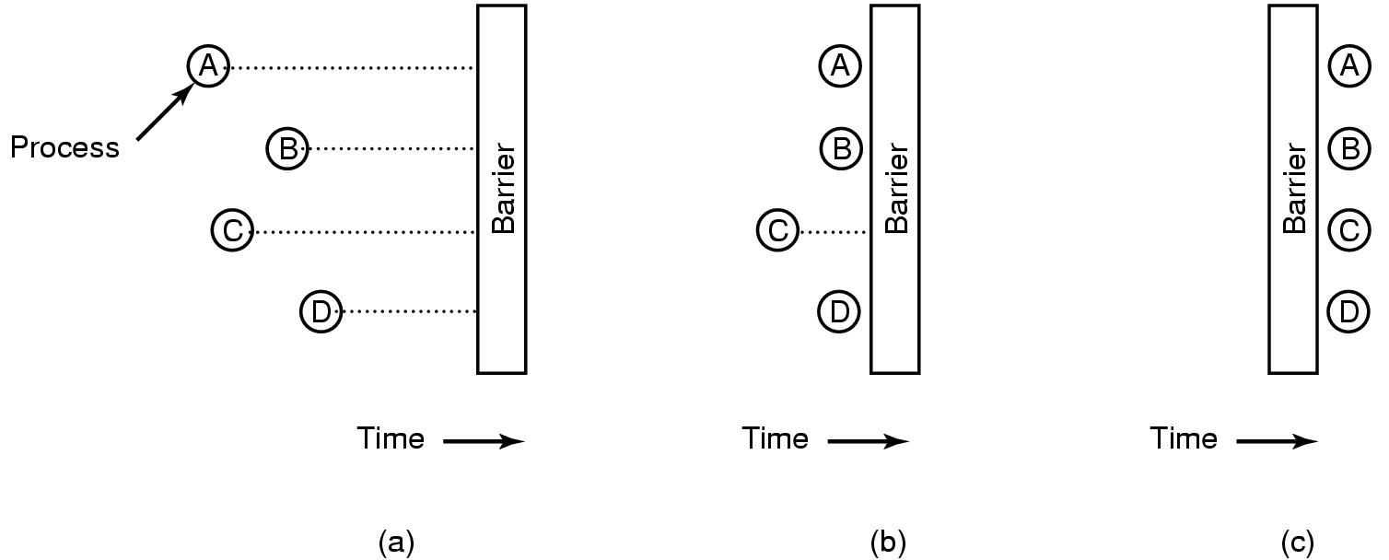
Barriers
. Barriers are intended for synchronizing groups of processes
Often used in scientific computations.
Tanenbaum, Modern Operating Systems 3 e, (c) 2008 Prentice-Hall, Inc. All rights reserved. 0-13-6006639

Slide 83
Who cares about scheduling algorithms?
Batch servers
Time sharing machines
Networked servers
You care if you have a bunch of users and/or if the demands of the jobs differ
Tanenbaum, Modern Operating Systems 3 e, (c) 2008 Prentice-Hall, Inc. All rights reserved. 0-13-6006639

Slide 84
Who doesn’t care about scheduling algorithms?
PC’s
  One user who only competes with himself for the CPU
Tanenbaum, Modern Operating Systems 3 e, (c) 2008 Prentice-Hall, Inc. All rights reserved. 0-13-6006639

Slide 85

Scheduling – Process Behavior
Bursts of CPU usage alternate with periods of waiting for I/O. (a) A CPU-bound process. (b) An I/O-bound process.
Tanenbaum, Modern Operating Systems 3 e, (c) 2008 Prentice-Hall, Inc. All rights reserved. 0-13-6006639

Slide 86
When to make scheduling decisions
New process creation (run parent or child)
Schedule when
  A process exits
  A process blocks (e.g. on a semaphore)
  I/O interrupt happens
Tanenbaum, Modern Operating Systems 3 e, (c) 2008 Prentice-Hall, Inc. All rights reserved. 0-13-6006639

Slide 87
Categories of Scheduling Algorithms
Batch (accounts receivable, payroll…..)
Interactive
Real time (deadlines)
Depends on the use to which the CPU is being put
Tanenbaum, Modern Operating Systems 3 e, (c) 2008 Prentice-Hall, Inc. All rights reserved. 0-13-6006639

Slide 88
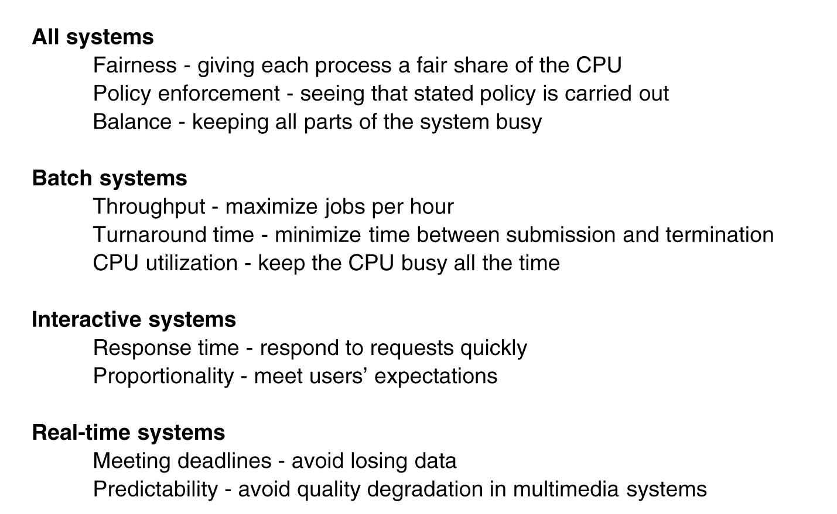
Scheduling Algorithm Goals
Tanenbaum, Modern Operating Systems 3 e, (c) 2008 Prentice-Hall, Inc. All rights reserved. 0-13-6006639

Slide 89
Scheduling in Batch Systems
First-come first-served
Shortest job first
Shortest remaining time next
Tanenbaum, Modern Operating Systems 3 e, (c) 2008 Prentice-Hall, Inc. All rights reserved. 0-13-6006639

Slide 90
First come first serve
Easy to implement
Won’t work for a varied workload
  I/O process (long execution time) runs in front of interactive process (short execution time)
Tanenbaum, Modern Operating Systems 3 e, (c) 2008 Prentice-Hall, Inc. All rights reserved. 0-13-6006639

Slide 91
Shortest Job First
Need to know run times in advance
Non pre-emptive algorithm
Provably optimal
Eg 4 jobs with runs times of a,b,c,d
First finishes at a, second at a+b,third at a+b+c, last at a+b+c+d
Mean turnaround time is (4a+3b+2c+d)/4
=> smallest time has to come first to minimize the mean turnaround time
Tanenbaum, Modern Operating Systems 3 e, (c) 2008 Prentice-Hall, Inc. All rights reserved. 0-13-6006639

Slide 92
Shortest Running Time Next
Pick job with shortest time to execute next
Pre-emptive: compare running time of new job to remaining time of existing job
  Need to know the run times of jobs in advance
Tanenbaum, Modern Operating Systems 3 e, (c) 2008 Prentice-Hall, Inc. All rights reserved. 0-13-6006639

Slide 93
Scheduling in Interactive Systems
Round robin
Priority
Multiple Queues
Shortest Process Next
Guaranteed Scheduling
Lottery Scheduling
Fair Share Scheduling
Tanenbaum, Modern Operating Systems 3 e, (c) 2008 Prentice-Hall, Inc. All rights reserved. 0-13-6006639

Slide 94
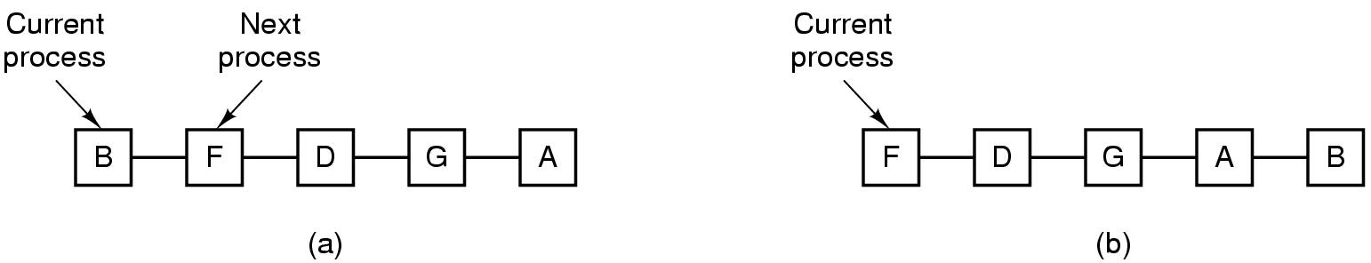
Round-Robin Scheduling
Process list-before and after
Tanenbaum, Modern Operating Systems 3 e, (c) 2008 Prentice-Hall, Inc. All rights reserved. 0-13-6006639

Slide 95
Round robin
Quantum too short => too many process switches
Quantum too long => wasted cpu time
  20-50 msec seems to be OK
Don’t need to know run times in advance
Tanenbaum, Modern Operating Systems 3 e, (c) 2008 Prentice-Hall, Inc. All rights reserved. 0-13-6006639

Slide 96
Priority Scheduling
Run jobs according to their priority
Can be static or can do it dynamically
Typically combine RR with priority. Each priority class uses RR inside
Tanenbaum, Modern Operating Systems 3 e, (c) 2008 Prentice-Hall, Inc. All rights reserved. 0-13-6006639

Slide 97
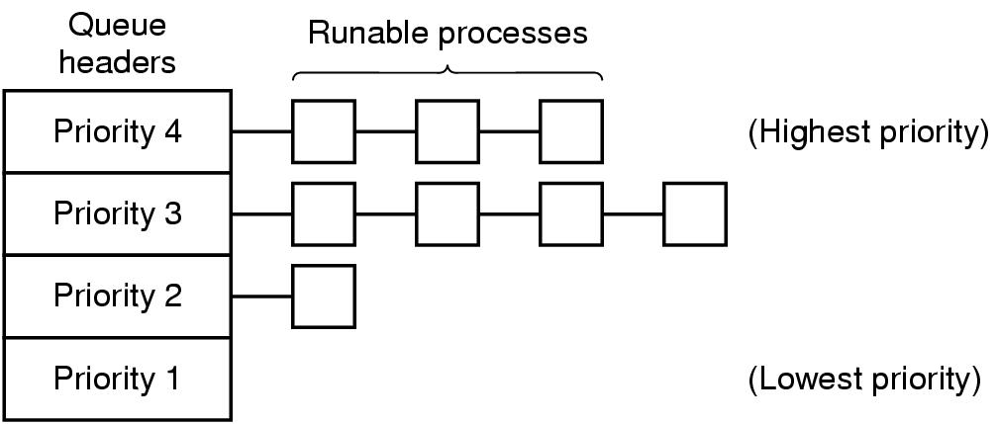
Priority Scheduling
Tanenbaum, Modern Operating Systems 3 e, (c) 2008 Prentice-Hall, Inc. All rights reserved. 0-13-6006639

Slide 98
Multiple Queues with Priority Scheduling
Highest priority gets one quantum, second highest gets 2…..
  If highest finishes during quantum, great. Otherwise bump it to second highest priority and so on into the night
Consequently, shortest (high priority) jobs get out of town first
They announce themselves-no previous knowledge assumed!
Tanenbaum, Modern Operating Systems 3 e, (c) 2008 Prentice-Hall, Inc. All rights reserved. 0-13-6006639

Slide 99
Shortest Process Next
Cool idea if you know the remaining times
exponential smoothing can be used to estimate a jobs’ run time
aT0 + (1-a)T1 where T0 and T1 are successive runs of the same job
Tanenbaum, Modern Operating Systems 3 e, (c) 2008 Prentice-Hall, Inc. All rights reserved. 0-13-6006639

Slide 100
Lottery Scheduling
Hold lottery for cpu time several times a second
Can enforce priorities by allowing more tickets for “more important” processes
Tanenbaum, Modern Operating Systems 3 e, (c) 2008 Prentice-Hall, Inc. All rights reserved. 0-13-6006639

Slide 101
Real Time Scheduling
Hard real time vs soft real time
  Hard: robot control in a factory
  Soft: CD player
Events can be periodic or aperiodic
Algorithms can be static (know run times in advance) or dynamic (run time decisions)
Tanenbaum, Modern Operating Systems 3 e, (c) 2008 Prentice-Hall, Inc. All rights reserved. 0-13-6006639

Slide 102
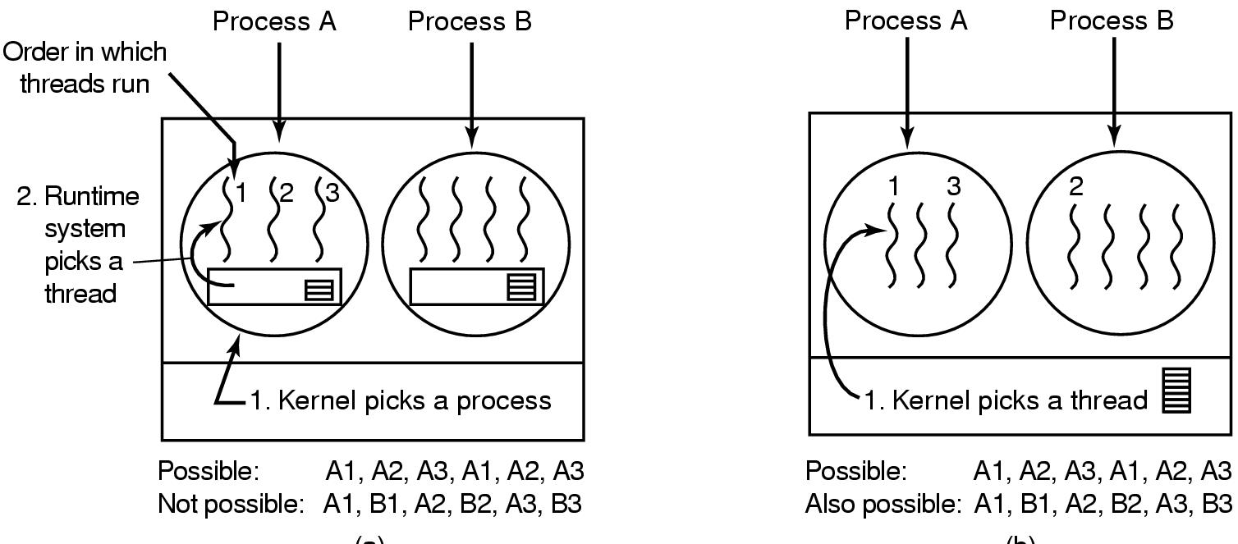
Thread Scheduling
Kernel picks process (left)
Kernel picks thread (right)
Tanenbaum, Modern Operating Systems 3 e, (c) 2008 Prentice-Hall, Inc. All rights reserved. 0-13-6006639

Slide 103

Dining Philosophers Problem
. Lunch time in the Philosophy Department.
Tanenbaum, Modern Operating Systems 3 e, (c) 2008 Prentice-Hall, Inc. All rights reserved. 0-13-6006639

Slide 104
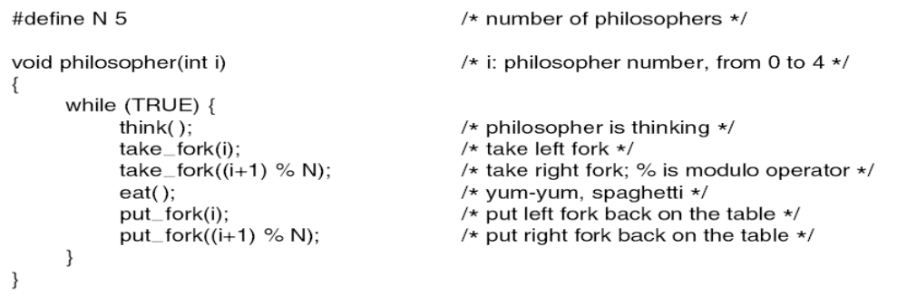
Dining Philosophers Problem
#define N 5 /*number of philosophers*/
Void philosopher(int i) /*i:philosopher number, from 0 to 4*/
{
While(TRUE){
think(); /*philosopher is thinking*/
take_fork(i); /*take left fork*/
take_fork(i+1)%N; /*take right for;% is modulo operator*/
eat(): /*self-explanatory*/
put_fork(i); /*put left fork back on table*/
put_fork(i+1)%N; /*put right fork back on table*/
}
}
A nonsolution to the dining philosophers problem.
Tanenbaum, Modern Operating Systems 3 e, (c) 2008 Prentice-Hall, Inc. All rights reserved. 0-13-6006639

Slide 105
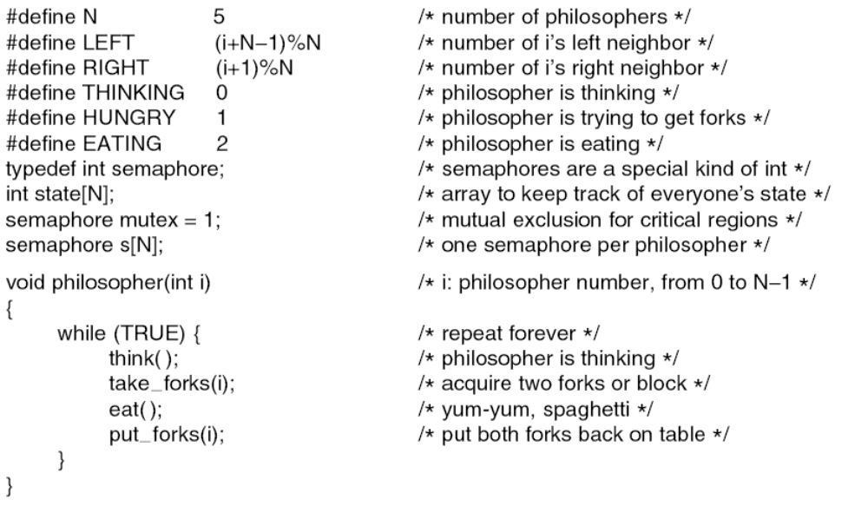
Dining Philosophers Problem
void philosopher(int i) /*philosopher I, 0…N-1*/
{
while(TRUE); /*repeat forever*/
think(); /*philosopher is thinking*/
take_forks(i); /*take 2 forks or block*/
eat();
put_forks(i); /*put forks back on table*/
}
}
. . .
A solution to the dining philosophers problem. N=5.
Tanenbaum, Modern Operating Systems 3 e, (c) 2008 Prentice-Hall, Inc. All rights reserved. 0-13-6006639

Slide 106
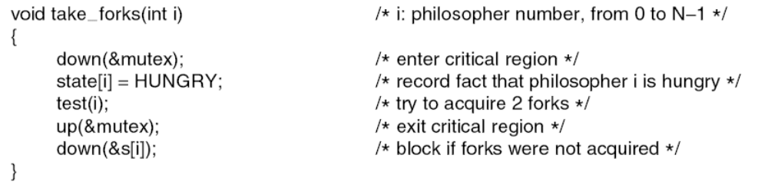
Dining Philosophers Problem
. . .
. . .
. A solution to the dining philosophers problem.
Tanenbaum, Modern Operating Systems 3 e, (c) 2008 Prentice-Hall, Inc. All rights reserved. 0-13-6006639

Slide 107
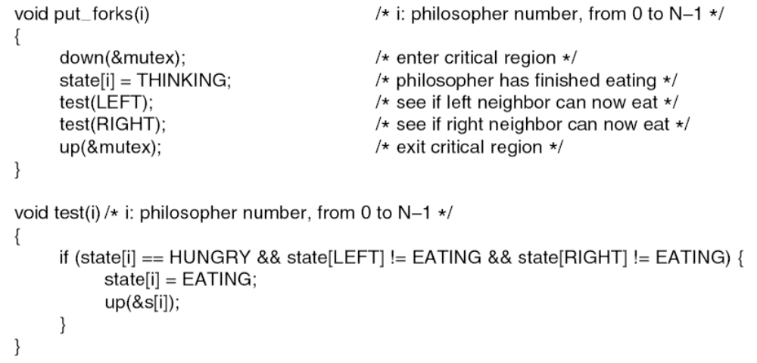
Dining Philosophers Problem (5)
. . .
A solution to the dining philosophers problem.
Tanenbaum, Modern Operating Systems 3 e, (c) 2008 Prentice-Hall, Inc. All rights reserved. 0-13-6006639

Slide 108
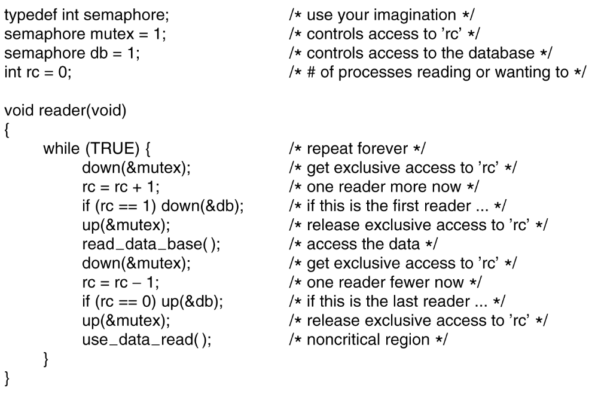
The Readers and Writers Problem (1)
. . .
A solution to the readers and writers problem.
Tanenbaum, Modern Operating Systems 3 e, (c) 2008 Prentice-Hall, Inc. All rights reserved. 0-13-6006639

Slide 109
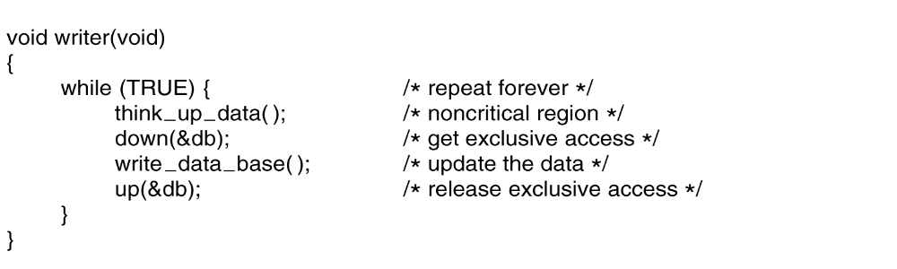
The Readers and Writers Problem (2)
. . .
. A solution to the readers and writers problem.
Tanenbaum, Modern Operating Systems 3 e, (c) 2008 Prentice-Hall, Inc. All rights reserved. 0-13-6006639

